Slide 1

Proximity/distance Measures-part 2
Dr. Umarani Jayaraman
Assistant Professor

Slide 2
Topic
Normalized Euclidean Distance
Quadratic Form Distance

Slide 3
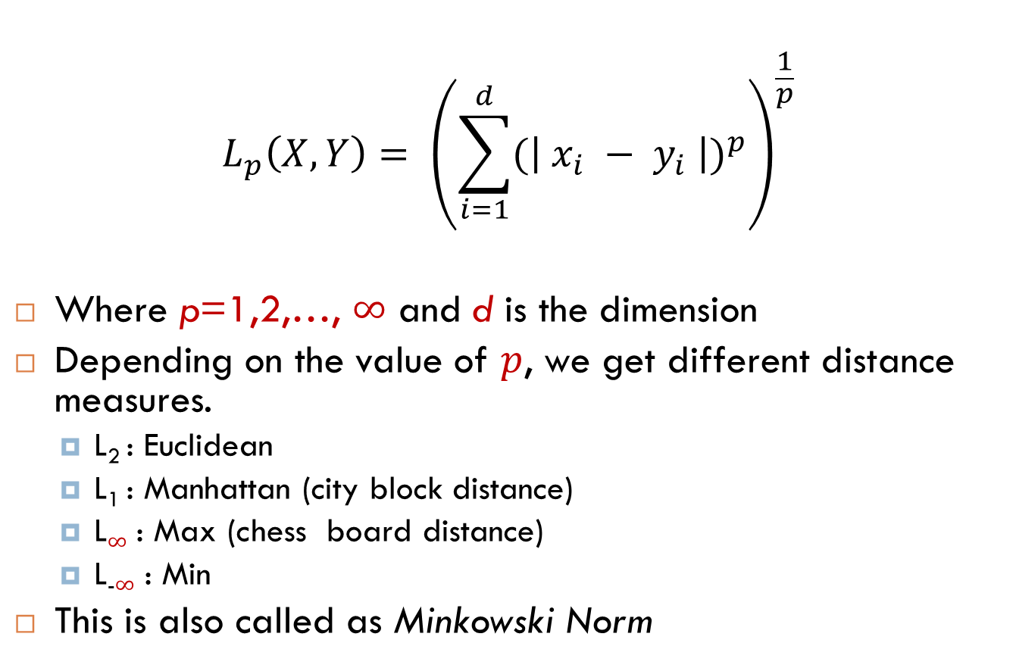
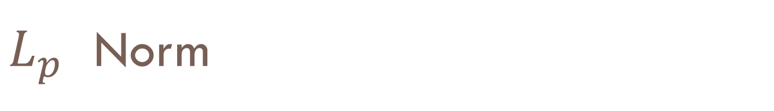
$L_{p}$ Norm
$$L_{p}\left(X,Y\right)= {\left(\sum_{i=1}^{d}{{(\left| x_{i} − y_{i} \right|)}^{p}}\right)}^{\frac{1}{p}}$$
Where p=1,2,…, $∞$ and d is the dimension
Depending on the value of $p$, we get different distance measures.
L₂ : Euclidean
L₁ : Manhattan (city block distance)
L$∞$ : Max (chess board distance)
L₋$∞$ : Min
This is also called as Minkowski Norm

Slide 4
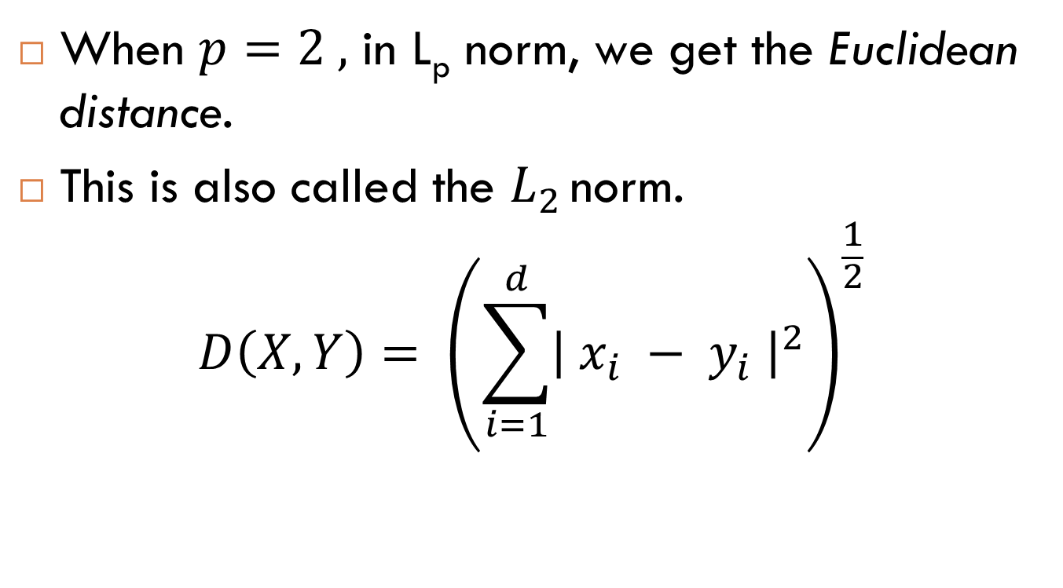
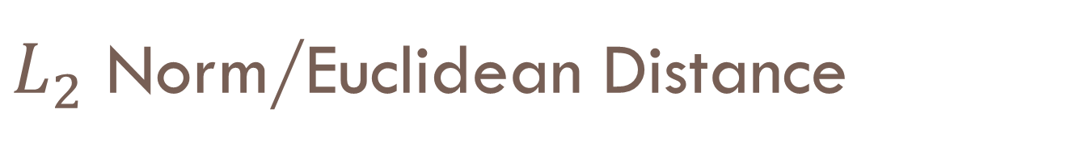
$L_{2}$ Norm/Euclidean Distance
When $p=2 ,$ in L_{p} norm, we get the Euclidean distance.
This is also called the $L_{2 }$norm.
$$D\left(X,Y\right)= {\left(\sum_{i=1}^{d}{{\left| x_{i} − y_{i} \right|}^{2}}\right)}^{\frac{1}{2}}$$

Slide 5
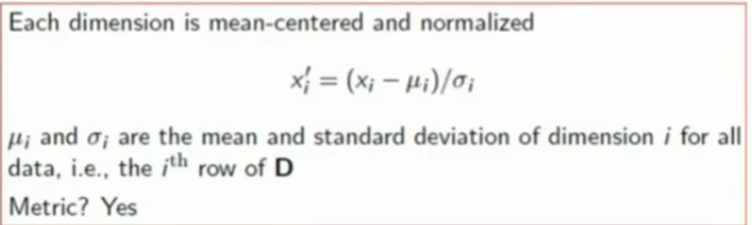

Normalized Euclidean Distance
When $p=2 ,$ in L_{p} norm, we get the Euclidean distance.
This is also called the $L_{2 }$norm.
$$NED\left(X,Y\right)= {\left(\sum_{i=1}^{d}{{\left| x_{i}′ − y_{i}′ \right|}^{2}}\right)}^{\frac{1}{2}}$$

Slide 6

Quadratic form distance
Quadratic form distance is a cross bin distance
It specifies cross-dependencies of the dimensions
It allows comparison of histograms across different bin locations

Slide 7
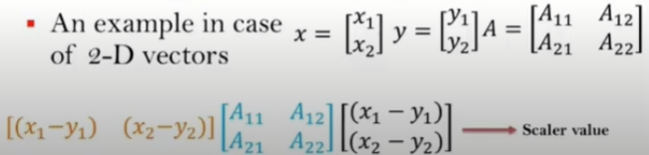
Quadratic form distance

Slide 8
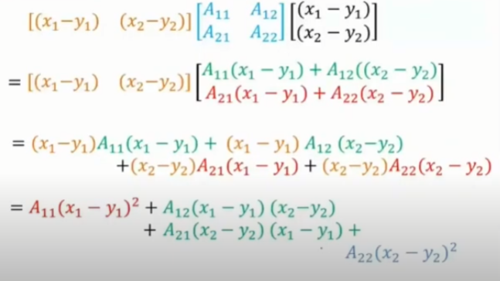
Quadratic form distances

Slide 9
Quadratic form distance
A is similarity matrix of size dxd
A_{ij} denotes the similarity (or weight) of dimension i with dimension j
Note: A is positive semi-definite (for distance to be ≥ 0)

Slide 10
Quadratic form distance
For example A_{ij}=1-c_{ij}/c_{max} for color histograms
c_{ij} is bin-to-bin distance and c_{max} the maximum distance
Note
If A is an identity matrix, then Euclidean
If A is a diagonal matric, then weighted Euclidean
Is it a Metric? Yes , if A is positive definite

Slide 11
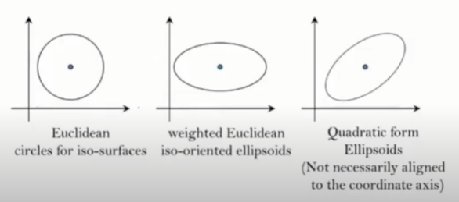
Quadratic form distance
QFD represents correlation between dimensions

Slide 12
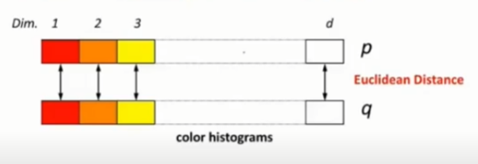
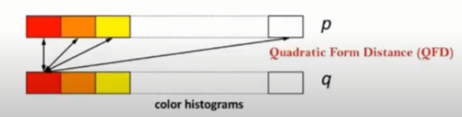
Application of QFD
Comparison of color histograms
Considers similarity between colors i and j

Slide 13
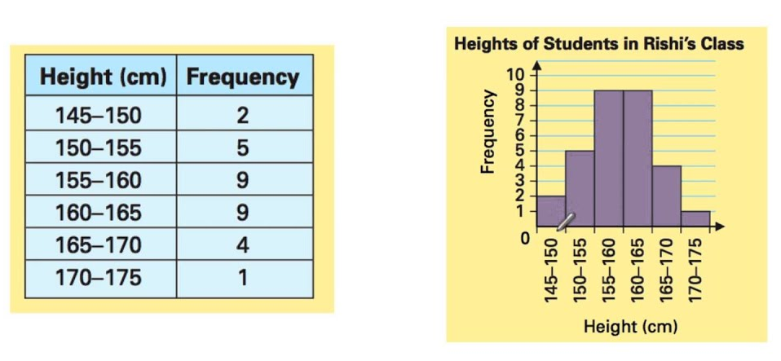
Application of QFD
Example of histogram

Slide 14
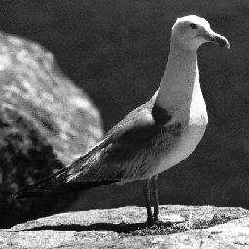
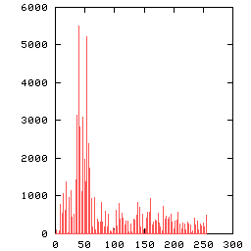
Application of QFD
Image
Histogram of the given image

Slide 15
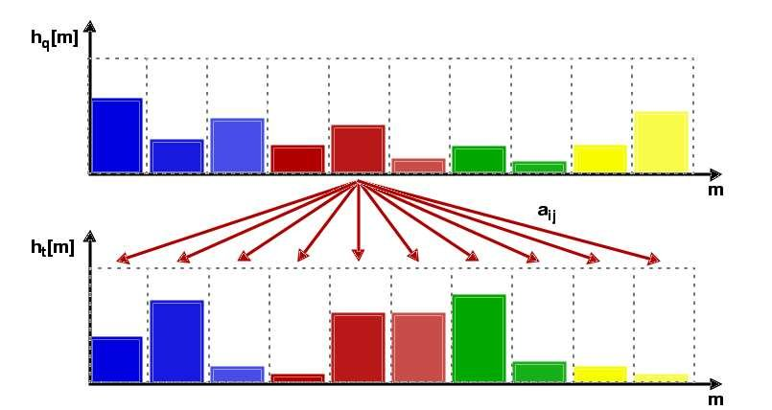
Comparison of color histograms
How to find the similarity weights?
Distance between the bins
Bin Distance = difference of indices

Slide 16
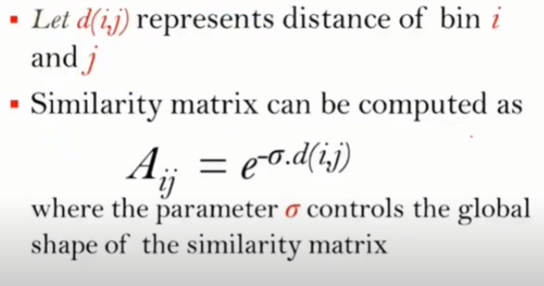
Comparison of color histograms

Slide 17



Comparison of color histograms
Database Image 1
Test Image
Database Image 2

Slide 18
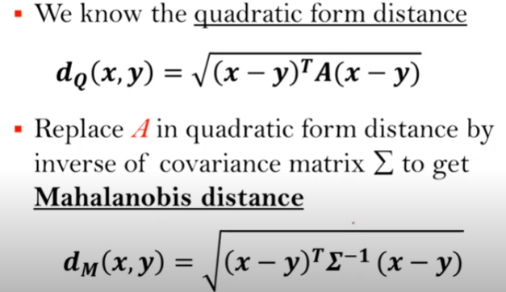
Mahalanobis distance

Slide 19
Quadratic form distance
For example A_{ij}=1-c_{ij}/c_{max} for color histograms
c_{ij} is bin-to-bin distance and c_{max} the maximum distance
Note
If A is an identity matrix, then Euclidean
If A is a diagonal matric, then weighted Euclidean
If A is an inverse of covariance matrix, then Mahalanobis distance
Is it a Metric? Yes , if A is positive definite

Slide 20
Summary
Metric distance measure
Quadratic form distance
Application of QFD

Slide 21
Thank you

